Slide 1

Digitalization Of Business Processes Project Case: Health Insurance Application
Group members:
Mohammad Ali Karimi
Pasquale Biafora
Florian Büttiker
Oliver Freiermuth
Thomas Geiser

Slide 2
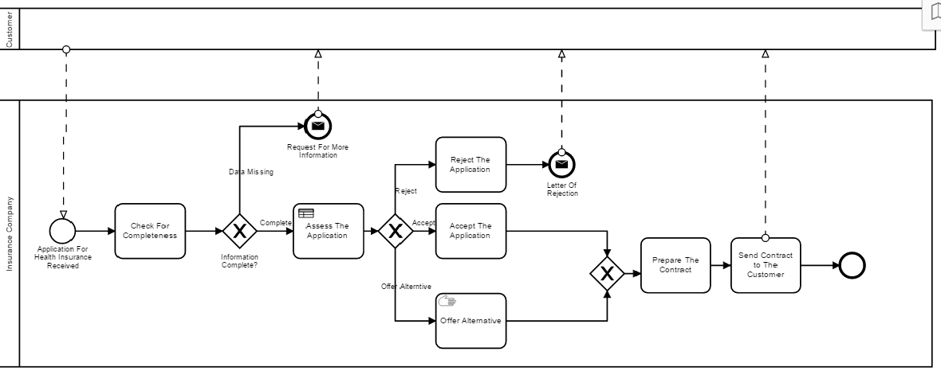
Register on GitHub, Download GitHub Desktop and Camunda Modeler
GitHub repository creation
Project Case: Health Insurance Application
Initial Process Modelling

Slide 3
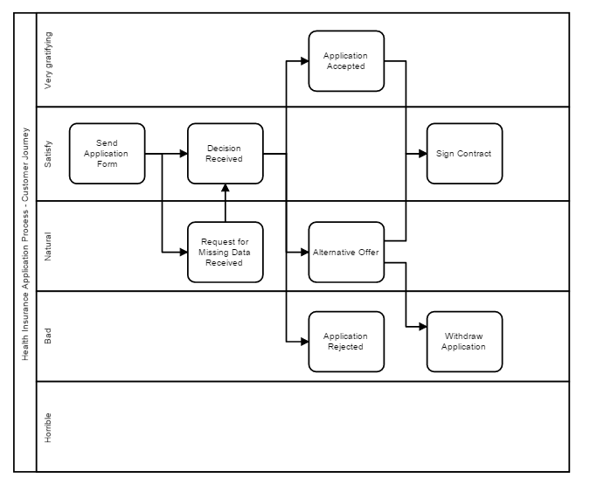
Customer Experience Model

Slide 4
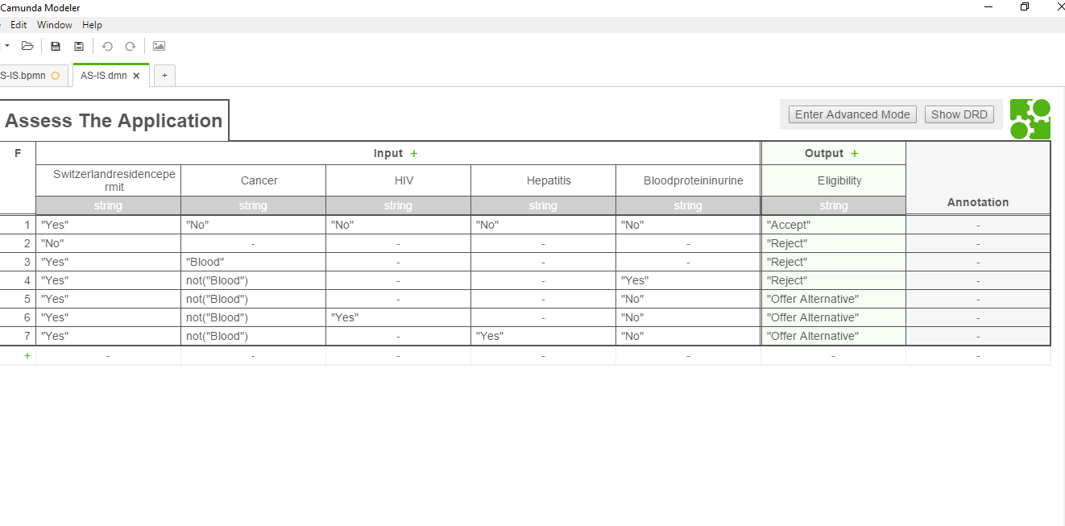
Modelling DMN or Decision modelling in Camunda Modeler

Slide 5
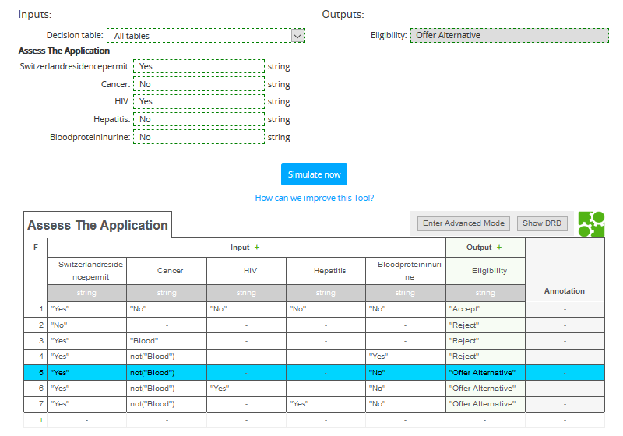
Simulating Decision Model

Slide 6
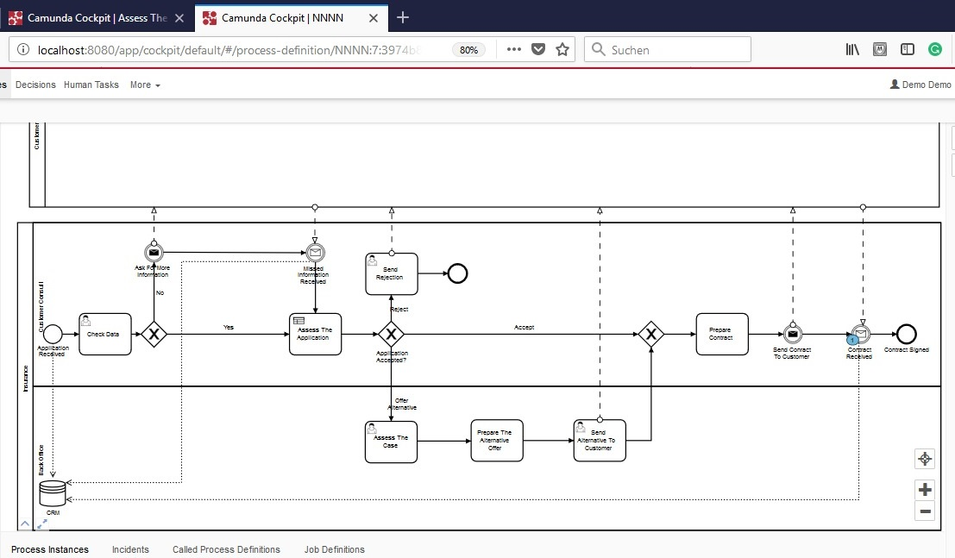
Executing Processes

Slide 7

Our Next Step …

